Slide 1

Unit 2: Introduction to KR
Computer Science Department
University of Verona - Italy

Slide 2
The problem of knowledge
Unit 2 – Lecture 2.1

Slide 3
AGENDA
The concept of knowledge The Knowledge Bases Semantic networks

Slide 4
WHAT IS KNOWLEDGE?
Knowledge (and its functions – acquisition, storage, communication, negotiation, fusion, update) is one of the key dilemmas in the relationship between human beings and reality Through knowledge, the process of cultural transmission takes place, which constitutes the quid of the differential between human beings and other species

Slide 5
KNOWLEDGE
Let's consider the following setting: Police raid a house; A police officer A enters a room; She sees that there are objects in the room, namely a table, chairs, and, on the table, a vase of flowers with tulips. Also on the side of the room there is, on the floor, a sleeping dog; She goes out, and tells police officer B, "It's a dining room, there's only one dog asleep."

Slide 6
KNOWLEDGE
Police officer B, at this point, reports to the command on the phone: "Commissioner, there is no significant issue here: a dining room, a sleeping dog, nothing to report." The command orders return to the barracks.

Slide 7
ANALYSIS AND DEFINITION OF PARAMETERS
The means of transmission used is THE DESCRIPTION; It uses IMPLICIT data, at different levels; It uses the RELEVANCE scheme; It is context-based.

Slide 8
ANALYTICAL EXAMPLE
In the previous setting, we imagine that it is not a policeman who enters, but a young painter who must report to the master; "There is a beautiful antique wooden table, a blue carpet with Persian designs on the floor, six modern chairs, with a steel shell and a full leather backrest. On the table is a blue vase with red tulips. A large Bernese Mountain Dog is lying on the ground. The tents are ecru, resting on the ground."

Slide 9
ANALYTICAL EXAMPLE
A real estate agent enters the room and writes a small report. "The room is rectangular, with a modestly sized centered window, a beautiful wooden floor and beautiful stucco. The front door is topped with a painted wooden joist."

Slide 10
ASPECTS, CONTEXTS, POINTS OF VIEW
The variants are
The purpose for which knowledge is represented; Who receives the information, and therefore what she already knows about the context; Hypotheses about that particular context.

Slide 11
Knowledge Engineering
Among the various problems of representation
General ontologies and categories Physical Objects and Substances Actions & Change, Events, Weather knowledge, beliefs... Mental aptitudes Reasoning Not Monotonous Uncertain, probabilistic reasoning.
We’ll look at two of them:
Reasoning about categories (semantic networks, frames... terminological or descriptive logics)
Probabilistic reasoning

Slide 12
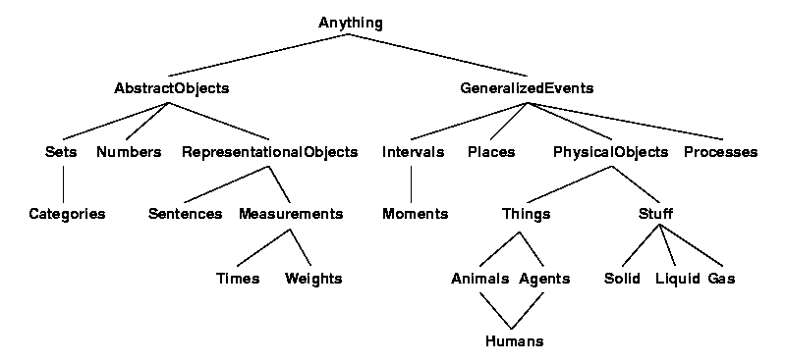
General or Higher Ontology

Slide 13
Psychological-linguistic approach to R.C.
The Logical Approach: To Formalize Valid Reasoning
Born for mathematics and then extended to "common sense" reasoning.
The cognitive-linguistic approach: emphasizes the mechanisms for the acquisition, structuring and use of knowledge
Strong synergies with: Cognitive Psychology Studies Natural Language Studies

Slide 14
Graphs
Precursor: Existential Graphs by Charles Pierce (1909)
∀x Strawbeery(x) ⇒ Red(x)
In logic, symbols are syntactically manipulated regardless of their meaning The truth of a formula depends solely on the truth of its sub-formulas and on the interpretation we give to primitive symbols
But the use of symbols (and the concepts they represent) is arbitrary and independent of the symbol used

Slide 15
Associationist theories
Associationist theories are concerned with the relationships between symbols and the meaning that arises from those associations
Ice
Snow
Water
Cold
Winter
White

Slide 16
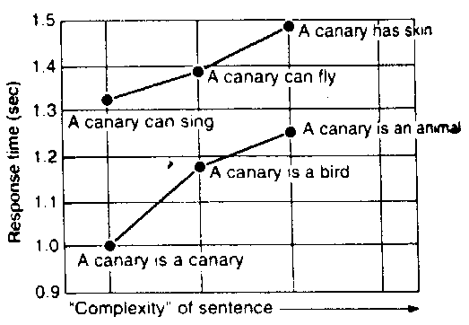
Hierarchical Organization of Concepts: Experiments (Collins, Quillian, 1969)
Questions:
1. "Is a canary a bird?" 2. »Does a canary flies?" 3. "Does a canary breathe? Response time: T1 < T2 < T3 Exceptions »Does an ostrich flies?" Immediate response

Slide 17
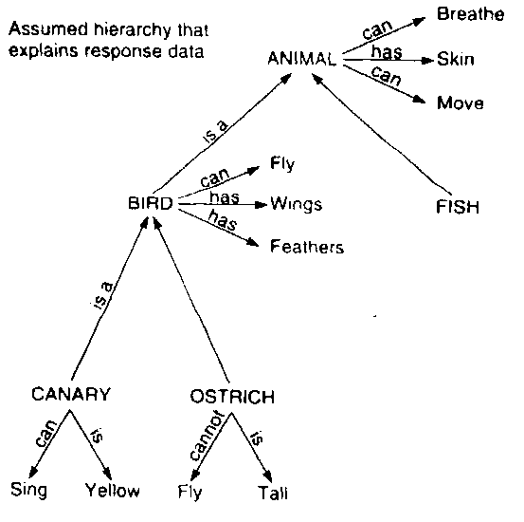
Hierarchical Organization of Concepts: Interpretation
Properties are "attached" to the more general concept to which they apply Exception Handling
Exceptions are stored directly with the object
Successful hierarchical structuring of concepts in computer science and SW engineering: OOL

Slide 18
Definition of Semantic Network
Semantic networks are a large family of "graph" representation schemes. A semantic network is a graph in which:
Nodes, labeled, correspond to concepts (individuals or classes) The arcs, labeled and oriented, to binary relationships between concepts (also called roles).
Two particular "primitive" relationships are always present:
IS, subclass relation ( ) IS-A, membership relationship ( )

Slide 19
An example of a semantic network

Slide 20
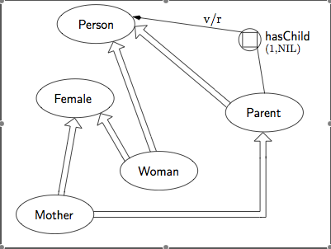
An example of a network

Slide 21
Inheritance in semantic networks
Inheritance as a particular inference related to the transitivity of IS Easily implemented as a link traversal Multiple inheritance
Person
hasChild
is
Parent
is
Mother

Slide 22
n-ary relations (n > 2)
From(John, Mary, book)
"John gives a book to Mary" This technique is called 'case structure representation'
Event-give
E1
hasAgent
hasRecipient
hasObject
John
book-4
Mary

Slide 23
Case Representation: Example

Slide 24
Expressivity of semantic networks
Limited expressive power: ∧, ∨, ⇒ ... not directly expressible
Proposition Nodes in Sowa Conceptual Graphs E.g. "There Are No Pink Dogs»
∀y ¬(dog(x)∧color(x,y)∧pink(y))
dog
color
pink

Slide 25
Expressivity of semantic networks
Partitioned networks in K-net [Fikes-Hendrix]
"All Mustangs are built by Ford»
∀x x∈Mustangs ⇒
∃y y∈Construction ∧ Object(y, x) ∧ Agent(y, Ford)
implies
construction
and
and
cons
ante
and

Slide 26
Lack of "semantics" in sematic networks
Woods [1975] and others point out ambiguities and inconsistencies in the use of knots and arcs, ... i.e. the lack of "semantics" of semantic networks Semantics are sometimes unclear or can only be derived from programs that use networks Examples of confusion
Same relationship for membership and subset Canonical instance or object class? Different meanings of relationships (between classes, between classes and objects, between objects)
Notes:
"Cirillo è un gatto"
"Cirillo è un gatto" come "Un gatto è un mammifero"
Gli italiani hanno nazionalità italiana vs Gli italiani hanno come numero 70 milioni.
"Mary è sorella di John" (tra due individui); Una persona ha per madre una femmina (tra classi); le persone hanno 2 gambe.

Slide 27
Semantic Networks and Logic
Semantic networks are a convenient notation for a part of the FOL, but they can still be traced back to a logical formalism Although not quite...

Slide 28
Logic Translation
Uppercase classes, lowercase individuals
∀x A(x) ⇒ B(x)
B(a)
∀x x ∈A ⇒ R(x, b)
∀x x ∈A ⇒ ∃y y∈B ∧ R(x, y)
IS
A
B
IS-A
a
B
R
A
b
R
A
B

Slide 29
An example of a translation
∀x Mammal(x) ⇒Animal(x)
∀x Mammal(x) ⇒HasNlegs(x, 4)
∀x Elefante(x) ⇒ Mammal(x)
∀x Elephant(x) ⇒ HasColor(x, grey)
Elephant(Clyde)
Then:
Animal(Clyde)
Mammal(Clyde)
HasNlegs(Clyde, 4)
HasColor(Clyde, grey)
Inheritance is
∀E, MP And transitivity of ⇒
Animal
IS
HasNlegs
Mammal
4
IS
HasColor
Elephant
grey
IS-A
Clyde

Slide 30
... What about the exceptions?
∀x Mammal(x) ⇒HasNlegs(x, 4)
∀x Bat(x) ⇒ Mammal(x)
∀x Bat(x) ⇒ HaNlegs(x, 2)
Pipistrello(Pat)
You infer:
HaNlegs(Pat, 2)
… but also
HasNlegs(Pat, 4)
Default reasoning requires nonmonotonic logic
HasNlegs
Mammal
4
IS
HasNlegs
Bat
2
IS-A
Pat

Slide 31
WordNet [Miller]
Large lexical resource organized as a semantic network (122,000 terms)
nouns, verbs, adjectives, adverbs are organized into sets of synonyms (synsets) that represent a concept (117,000 synsets);
A set of synsets is typically associated with the word: the senses of the word
http://wordnet.princeton.edu/

Slide 32
WordNet: Examples of Use
Expansion of queries with synonyms or hypernyms in keyword-based search (first you need to identify the right meaning) Semantic distance between words Semantic category of the term or supersense:
person, organization, place, measure...

Slide 33
Frames
Knowledge is organized into complex mental structures, frames [Minsky, 1974]. Essence of the theory: "When encountering a new or unforeseen situation, a complex mental structure is evoked by memory, which, by a process of instantiation, is adapted to the specific situation and provides a key to interpretation for it." Data structure to represent "stereotypes", the fundamental role of defaults

Slide 34
"Frames" as a data structure
Conditions for activation Collection of slot-filler pairs (attribute-value)
Fillers can have different aspects (facets) Specific value value restriction, reference to another frame default value
A procedure to be triggered when the slot receives a value (if-added) or the slot value is required (if -needed) daemons or procedural attachments
Particular slots are IS and IS-A for hierarchical organization of frames in frame systems

Slide 35
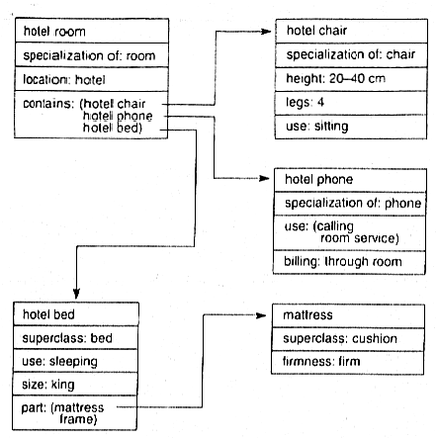
Example: A hotel room

Slide 36
Frames and logic
Natural concepts, unlike mathematical concepts, rarely admit of definitions of the kind necessary and sufficient
Quadrilater (x) ⇔ Polygon(x) ∧ N-edges(x,4)
Bird(x) ⇔ Two-legged(x) ∧ Feathered (x) ∧ Flies(x) … ?

Slide 37
Prototypes
What typically characterizes a concept ... Necessary conditions
Bird(x) Vertebrate (x) Bird (x) Two-legged (x)
Typically Necessary Conditions (Default)
Bird(x) Tip Fly(x) Bird(x) Feathered Tip(x)
Sufficient conditions (criteria)
Canary(x) Bird(x) Ostrich(x) Bird(x)
Typically sufficient conditions
Fly(x) Chirp(x) Tip Bird(x) Feather(x) Tip Bird(x)
Reasoning with prototypes is also a source of non-monotony

Slide 38
FrameNet [Lowe, Baker, Fillmore]
A resource consisting of collections of syntactically and semantically annotated sentences, organized in frames. Frame-based semantics: the meaning of words arises from the role they play in the conceptual structure of sentences Knowledge is structured in 16 general domains: time, space, communications, cognition, health... 6000 lexical elements; 130,000 annotated sentences
http://berkeleyfn.framenetbr.ufjf.br/

Slide 39
Introduction to DL
Unit 2 – Lecture 2.2

Slide 40
Course plan (remainder)
We are now able to start discussing about the Description Logics
Systems to represent knowledge
Serious attempt to look at the semantic web goals
Incorporate reasoning

Slide 41
Course plan (remainder)
Therefore we are now into
Studying the DL
Structural
Propositional
Predicative
Studying a language for XML serialization
RDF
OWL-DL
Studying an application for OWL-DL
Protégé

Slide 42
DESCRIBING THE WORLD
To describe objects in the above contexts, the following are used:
Object properties; Membership in known classes; Operators that allow you to represent the nature of properties.

Slide 43
Categories & Objects
A lot of the reasoning that is done is about categories rather than individuals If we organize knowledge into categories (and subcategories) it is sufficient to classify an object, by means of perceived properties, to infer the properties of the category to which it belongs Inheritance as a form of inference

Slide 44
Domain ontologies
The ideas of semantic networks and frames have been collected in specialized logics These logics are the basis of the proposals for the Semantic Web Ontology: formal model of a domain of interest (a conceptualization) Subclass relationships organize knowledge into taxonomies (as in botany, biology, library science...)
Notes:
Nel Semantic Web si ipotizza di costruire basi di conoscenze in cui gli oggetti di interesse per il Web sono descritti in un linguaggio di rappresentazione ricco e condiviso.
Per lo scambio di oggetti strutturati si prevede l'uso di XML, un meta-linguaggio per costruire linguaggi di annotazione standard.

Slide 45
The Semantic Web
Tim Berners-Lee's (1998) vision: from a "syntactic" Web for communication between people to the "semantic" Web, a large network of information connected on a global scale that can be understood by programs (a global database – linked data) The vehicle is XML, a generic annotation language.
Notes:
Semantic Web al W3C (http://www.w3.org/2001/sw/)
Semantic Web Road map (http://www.w3.org/DesignIssues/Semantic)
XML: machine readable
RDF: machine understandable

Slide 46
Motivations for the semantic web
Today's web, made up of documents, is only suitable for people to use
Search engines are based on keywords, and the results are documents, not data that can be used by programs It's impossible to build programs that make effective use of web content
The semantic web aims to help in the management of knowledge present on the web
A web of data to be shared and reused across applications, businesses and communities

Slide 47
A problem?
Could LLMs be seen as a threat to traditional search engines such as google?
Is this the case for Semantic Web applications?
Is an LLM a SW application?

Slide 48
Semantic Web and Knowledge Management
Information Sourcing
Less syntactic searches
Information Extraction
Now it's the people who research, interpret and combine the content of web pages
Information Maintenance
Inconsistent terminologies, outdated information
Presentation of the information
Unable to define "views" on web content

Slide 49
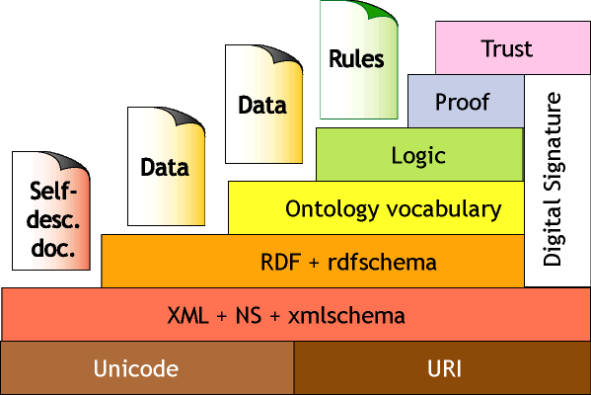
The layers of the Semantic Web

Slide 50
The layers of the Semantic Web
Unicode and URIs XML Syntactic Interoperability RDF (Resource Description Framework): to describe semantic relationships between resources (subject, predicate, object) RDF schema (RDFS): to constrain domains and codomains of relationships, define object classes, class relationships; RDFS is a language for ontologies, not very expressive

Slide 51
Semantic Web and Languages for Ontologies
Languages for adding an inferential service to RDF: ILO European Group
DAML-ONT American Group DAML+OIL proposed as standard OWL: Web Ontology Language, W3C standard. OWL evolves from descriptive logics

Slide 52
KNOWLEDGE BASES
A knowledge base is a system of conceptual structures (an ontology) applied to objects described in the KB (instances)

Slide 53
A KB based on descriptive logic
Top
creator
book
author
journalist
(and book
(all author journalist))
bottom
KB
T-BOX
Top
scrittore
libro
giornalista
(and libro
(all autore giornalista))
bottom a2
journalist ⇒ author
paper ⇔
(and (a-not book)
(all author journalist))
author ⇒ creator
A-BOX
author[Eco, l1]
author[Biagi, l2]
journalist[Biagi]
(and book
(all author
journalist))[a2]
Notes:
La T-BOX definisce la terminologia di un dominio, la definizione di concetti e ruoli complessi a partire da concetti e ruoli primitivi.
La T-BOX rappresenta la conoscenza intensionale.
La T-BOX definisce relazioni di sussunzione tra concetti e consente di classificarli in una gerarchia di erditarietà, in realtà un reticolo con un TOP e un BOTTOM.
La A-BOX definisce la conoscenza estensionale, una serie di fatti specifici e contingenti che riguardano individui,

Slide 54
TERMS FOR CLASSIFYING DL
AL The Attribute Logic N Numeral quantifiers C Negation S Transitive Role Closure (ext) H The hierarchy of roles O Enumeration operator I Role inverse F Functional restriction Q Qualified restriction D Concrete domains

Slide 55
STRUCTURAL CALCULI
Introduction to descriptive calculi: structural calculi.
The AL Logic The ALN Logic

Slide 56
PRESENTATION OF AL LOGIC
AL Logic is structured as an extended propositional logic;
The signature consists of Atomic concepts marked by A, B, C... Roles marked with P, Q, R... ⊓, ¬, ∀, ∃ operators Special symbols ⊤, ⊥ Definition symbols ⊑, ≡

Slide 57
WFF OF AL
Concepts are the expressions structured as follows:
If α is an atomic concept, then
¬α is a concept (atomic negation)
If α and β are concepts, then
α ⊓ β is a concept; ⊤, ⊥ are concepts
If α is a concept and R is a role
∀R.α is a concept (value restriction); ∃R.⊤ is a concept (limited existential quantifier)

Slide 58
DEFINITIONS
There are two types of definitions allowed in a descriptive logic Inclusion axioms
A ⊑ C, with atomic A
Proper definitions
A ≡ C, with atomic A

Slide 59
TERMINOLOGY
A terminology is a finite set of proper definitions and inclusion axioms

Slide 60
SEMANTICS OF AL
To interpret AL, we choose an interpretation domain consisting of a set Δ, and sets up a function that associates
To the concepts, subsets of Δ; To the roles, subset of Δ².

Slide 61
INTERPRETATION
Specifically, the interpretation of an expression is defined as follows:
(¬𝛼)^{J} = 𝛥 - 𝛼^{J}
(𝛼 ⊓ β)^{J} = 𝛼^{J} ⋂ β^{J}
⊤^{J} = 𝛥
⊥^{J} = ∅
(∃R.⊤)^{J} = {x ∊ 𝛥 | ∃y ∊ 𝛥, (x,y) ∊ R^{J}}
(∀R.𝛼)^{J} = {x ∊ 𝛥 | ∀y ∊ 𝛥, (x,y) ∊ R^{J} ➝ y ∊ 𝛼^{J}}

Slide 62
EXAMPLES
Represent in AL
A: Those who have only male children B: Those who have only daughters C: Those who have at least one child Q: Those who have at least one daughter female

Slide 63
REPRESENTATION
We assume
Person, Male, Female PRIMITIVE CONCEPTS hasChild ROLE

Slide 64
EXAMPLE DEFINITIONS
Male ⊑ Person Female ⊑ Person
A ≡ Person ⊓ ∀hasChild.Male
B ≡ Person ⊓ ∀hasChild.Female
C ≡ Person ⊓ ∃hasChild.T
D ≡ ??? (D ≡ Person ⊓ ∃hasChild.Female)

